Slide 1

OU Prediction Challenge
Team - Abraca-data
Pritesh Bhomick

Slide 2

Steps followed for part (I)
Read train data
Remove columns custID, year, date, month as they are not useful for prediction. Make sure to not use sessionId for prediction
Find missingness in the remaining dataset
Remove columns with greater than 20% missingness
Impute the remaining columns with missing values using kNN
Generate dummy variables for factor variables
Remove columns with near zero variance for the dataset
Remove columns having > 0.9 or < -0.9 variance between them
Left with 25 numeric and dummy variables as predictors
Convert revenue to positiveTransaction and make it a factor variable
Apply random forest to the remaining columns to predict the positiveTransaction and create model
Apply the model to the test data and submit the results

Slide 3
Steps followed for part (II)
Read train data
Remove columns sessionID, year, date, month as they are not useful for prediction. Make sure to not use custId for prediction
Find missingness in the remaining dataset
Remove columns with greater than 20% missingness
Impute the remaining columns with missing values using kNN
Generate dummy variables for factor variables
Remove columns with near zero variance for the dataset
Remove columns having > 0.9 or < -0.9 variance between them
Left with 25 numeric and dummy variables as predictors
Apply random forest to the remaining columns to predict the revenue and create model
Apply the model to the test data
Merge duplicate custIds to add up the revenues generated by each
Submit the predicted revenue from each custId

Slide 4
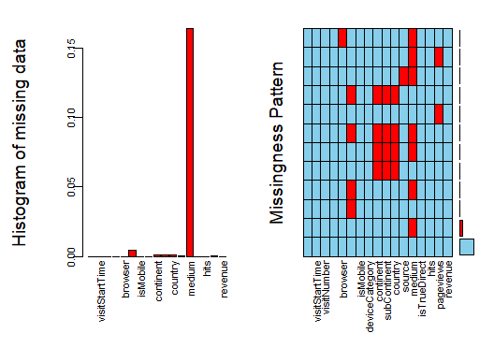
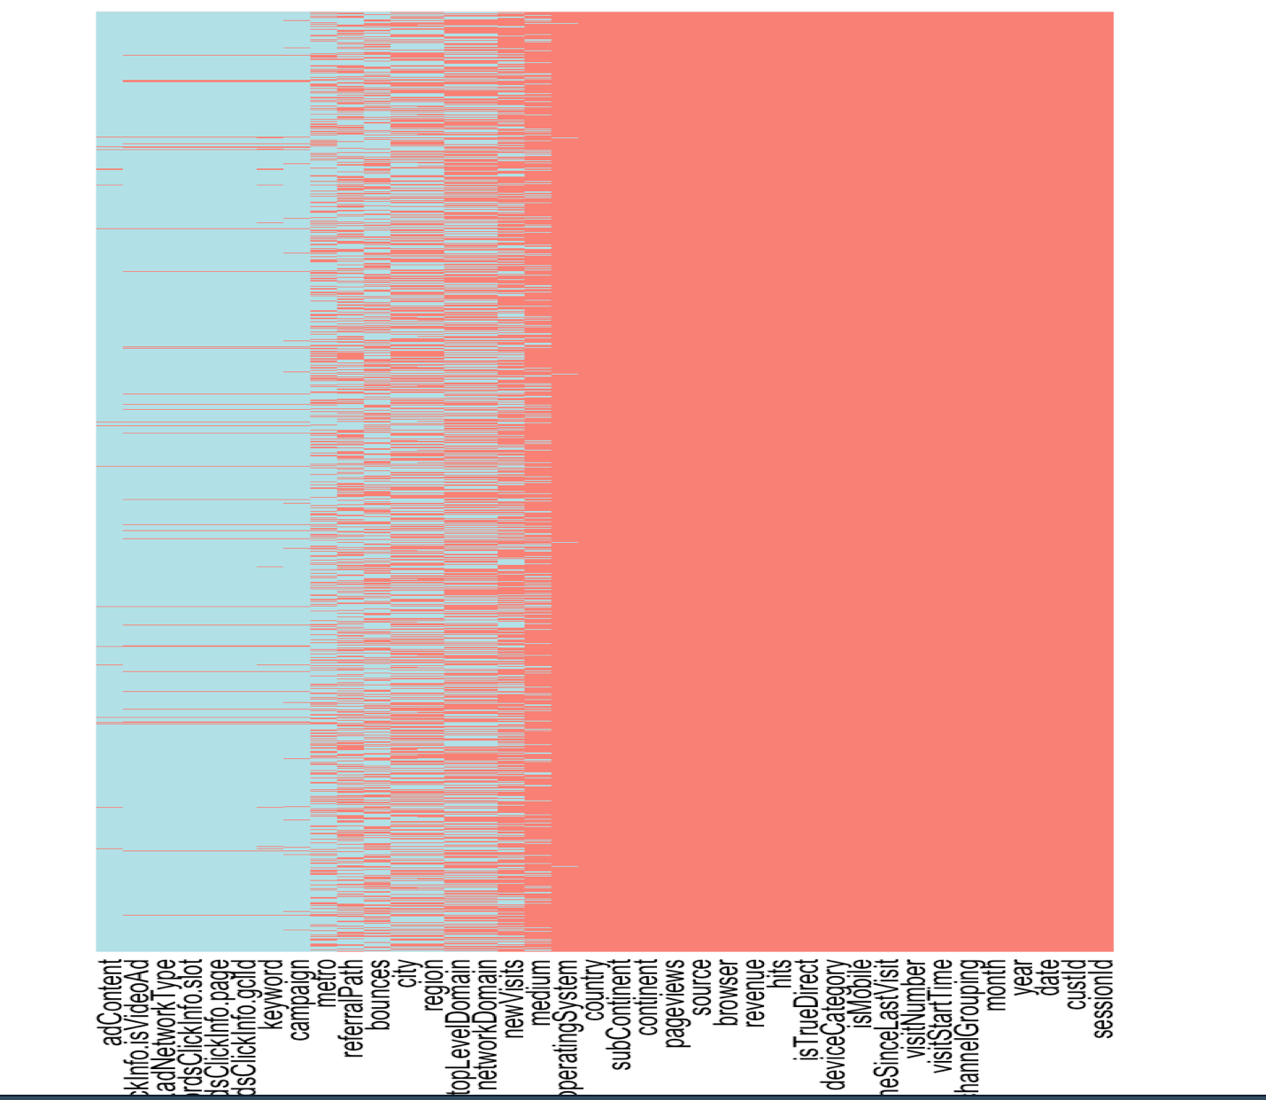
Missingness in the train data

Slide 5
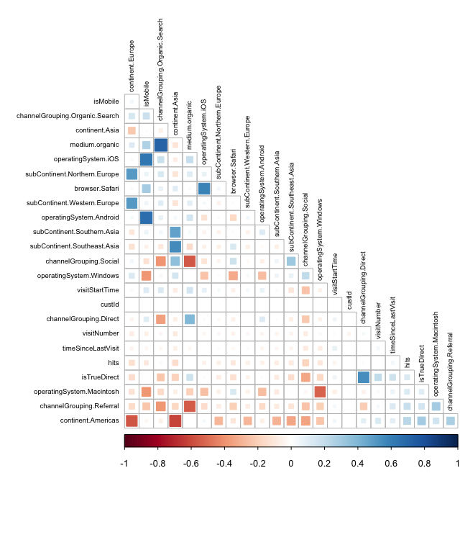
Correlation in the data after handling missingness

Slide 6
Prediction performance on 30% test data
Part (i)
Best F1 = 0.95291
Part (ii)
Best RMSE = 743.17156

Slide 7
THANK YOU

